Slide 1



July 2019
GHILG EEOC Update
Joe Bontke M.Ed.
Education & Outreach Coordinator
713 907 2855 cell
713 651 4994 Desk
joe.bontke@eeoc.gov
@EEOC_Houston
Joe Bontke

Slide 2
Local EEOC Management
District Director Rayford Irvin
Deputy Director Travis Nicholson
Regional Attorney Rudy Sustaita
Chief Administrative Judge Justin Evans
Enforcement Manager Elizabeth Henderson
Outreach Manager Joe Bontke
ADR Coordinator Jennifer Ortiz-Prather

Slide 3
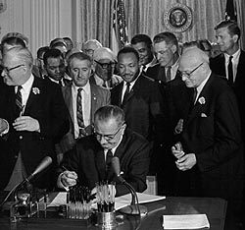
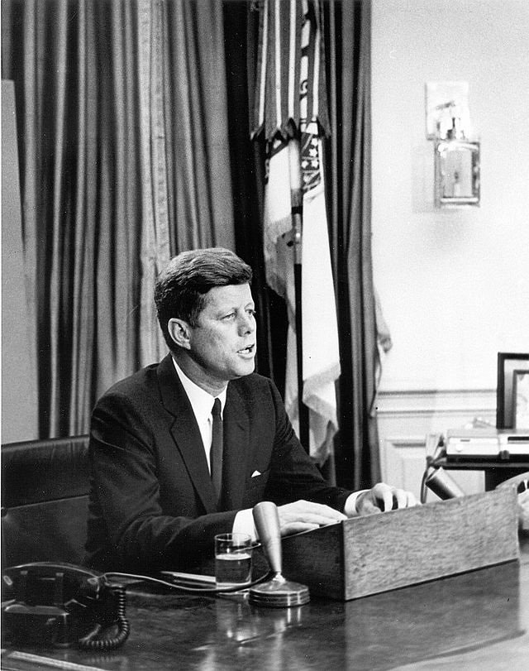
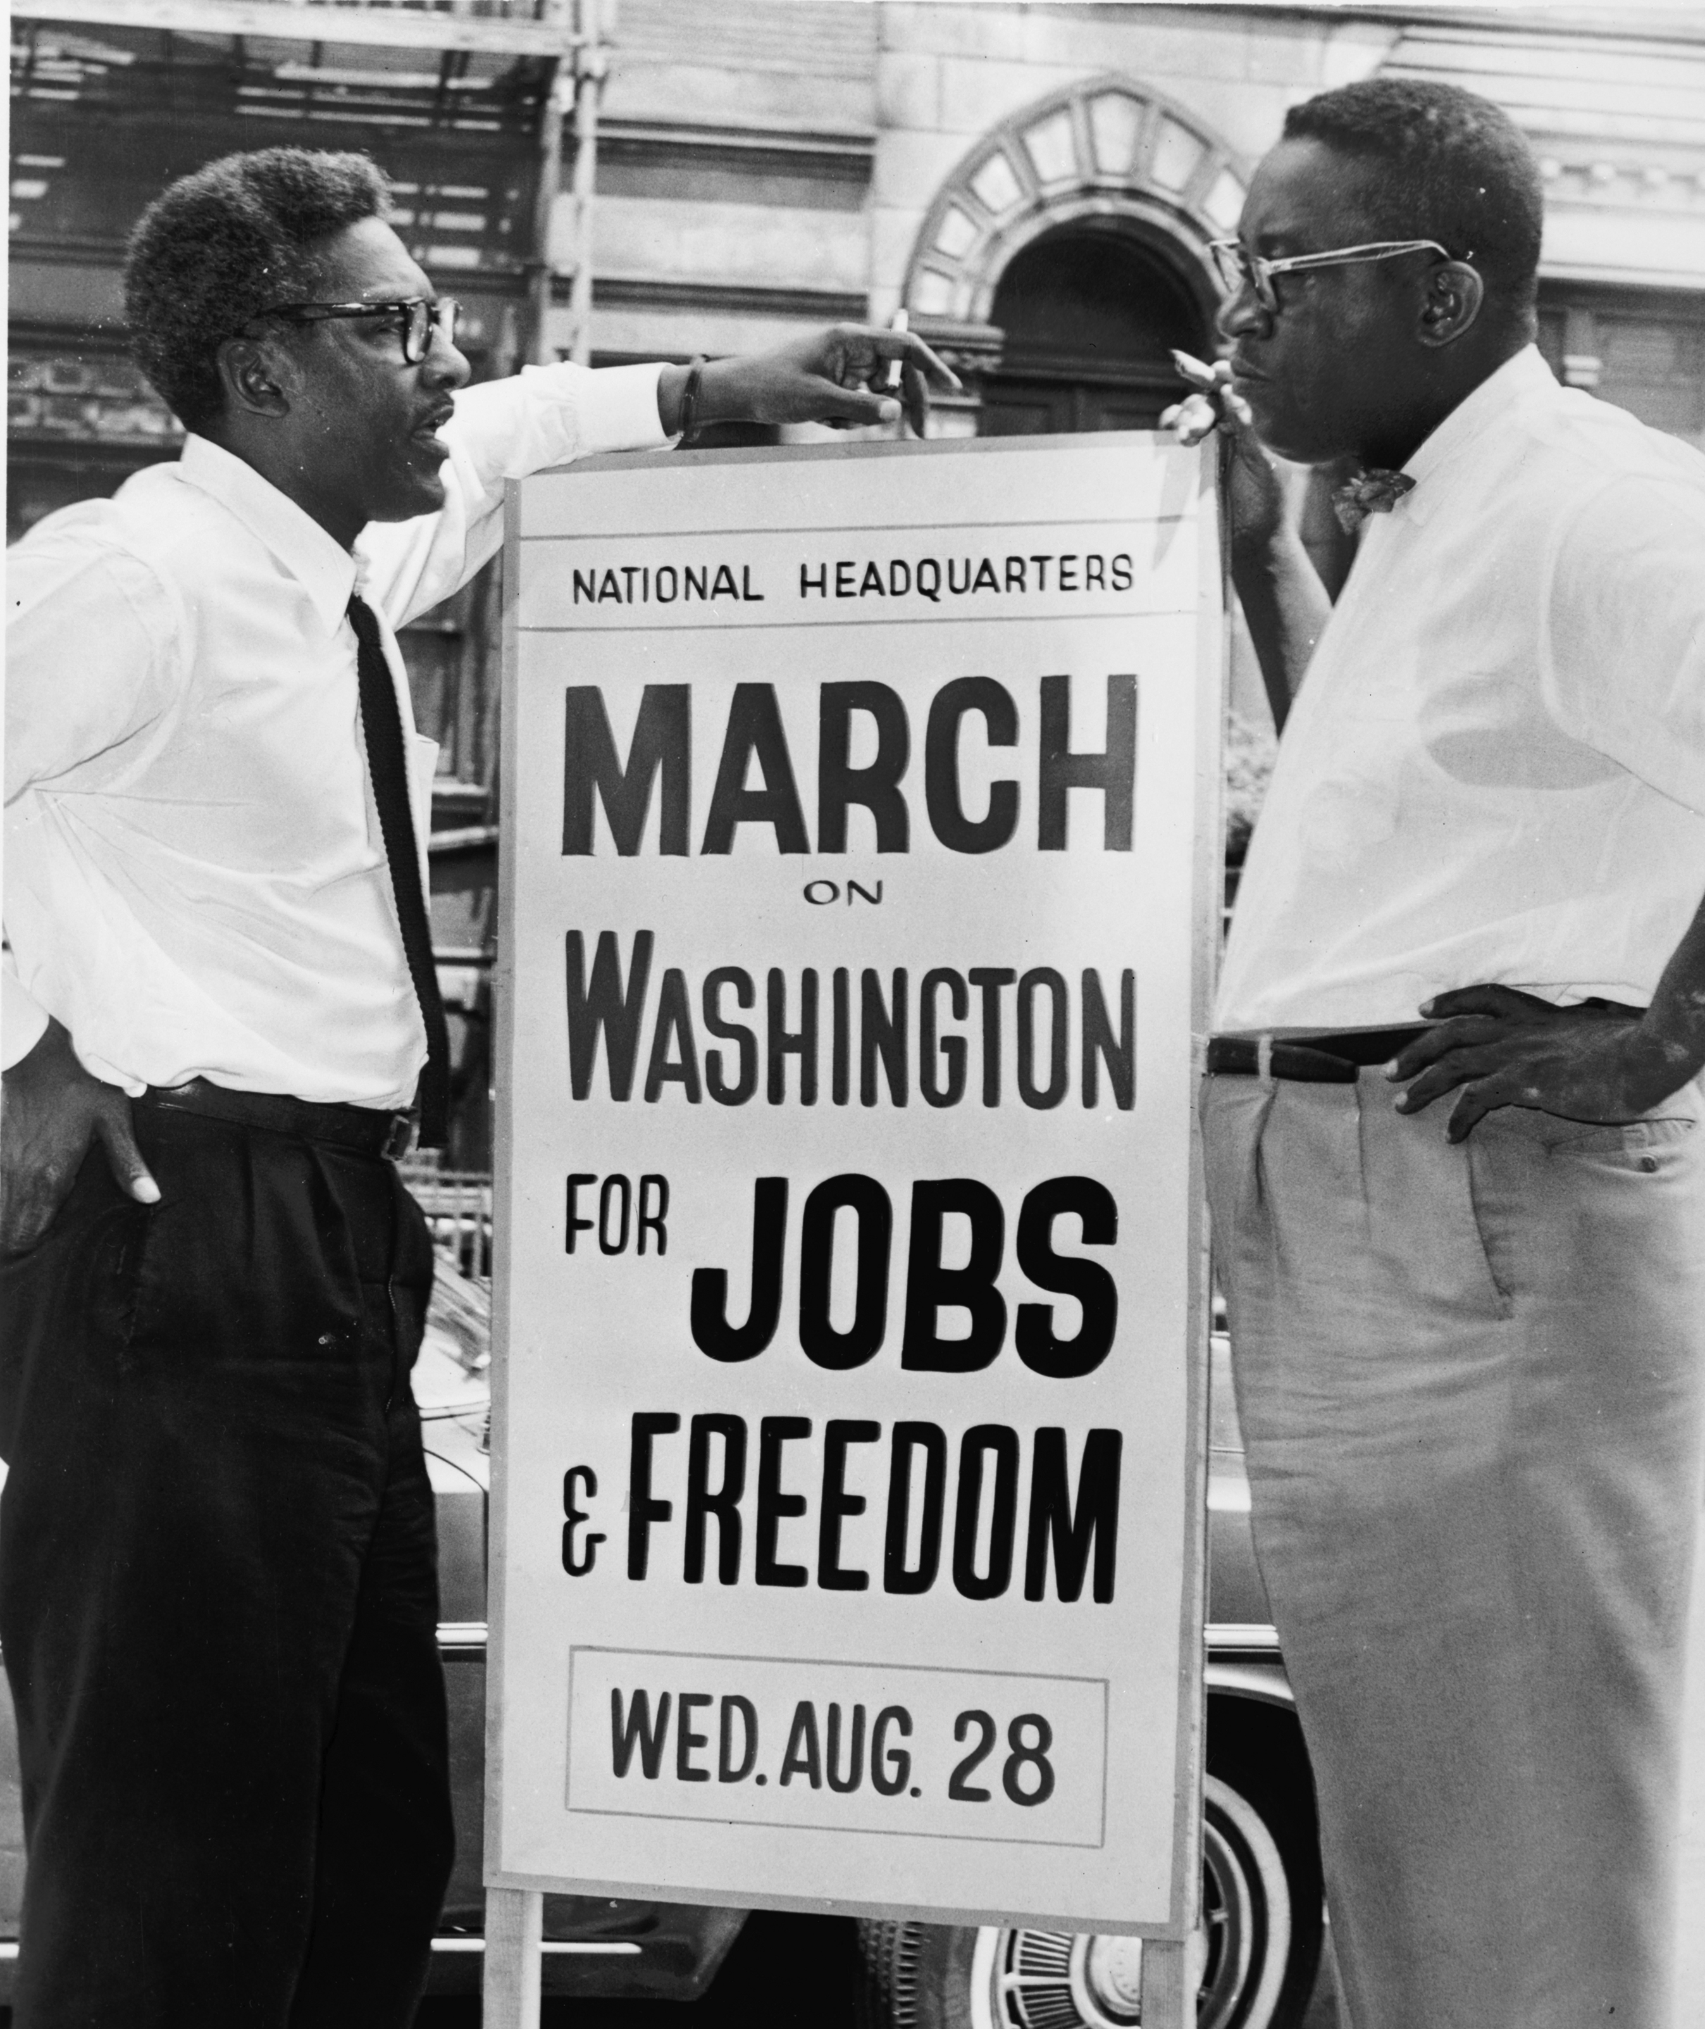
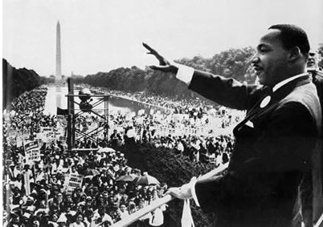

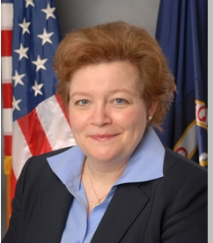
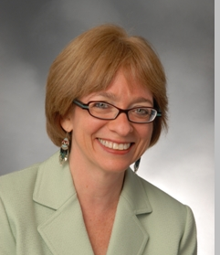
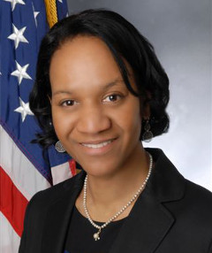
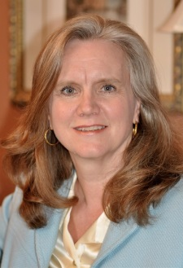
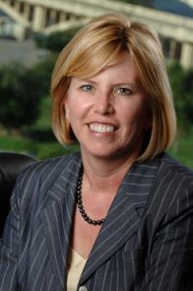
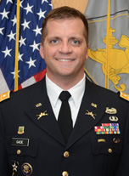
U.S. Equal Employment
Opportunity Commission
In 2018
Nominated Chair:
Janet Dhillon
Nominated:
Daniel Gade
Acting Chair: Victoria Lipnic
Chai Feldblum
Charlotte Burrows
Nominated:
General Counsel
Sharon Fast Gustafson
Notes:
EEOC was created over 50 years ago as part of the Civil Rights Act of 1964
independent regulatory commission enforcing federal anti-discrimination laws (employment only)
VISION Justice and Equality in the Workplace
MISSION Stop and Remedy Unlawful Employment Discrimination
HQ Washington, 53 field offices. 15 districts
SF District = N. California, N Nevada, Alaska, Washington, Oregon, Idaho, Montana.
Commission consists of five Senate-confirmed Commissioners.
No more than three Commissioners can be from the same political party.
Commissioners serve for set terms of 5 years.
Commission voted on a Strategic Enforcement Plan for 2017-2021.
Commission has a bipartisan commitment to enforcing the law and helping employers comply with the law.
Sharon Fast Gustafson is a solo practitioner in Arlington, Virginia. She received her J.D. from Georgetown University Law Center, cum laude, in 1991. After law school she worked for four years in the labor and employment law group at Jones, Day in Washington, D.C.
Ms. Gustafson now practices in Virginia, Maryland, and the District of Columbia. She advises and represents both employees and employers in employment-related legal matters. She was awarded Lawyer of the Year (2016) by the Metropolitan Washington Employment Lawyers Association. She is a member of the National Employment Lawyers Association and the Federal Bar Association.
Ms. Gustafson was counsel for Peggy Young in Young v. United Parcel Service, 2011 WL 665321 (D.Md.), aff'd, 707 F.3d 437 (4th Cir. 2013, rev'd and remanded, 575 U.S. ____, 135 S. Ct 1338 (2015).

Slide 4
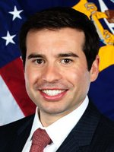
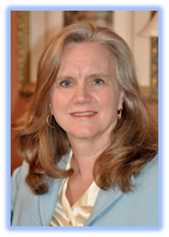
U.S. Equal Employment
Opportunity Commission
As of
July 8th 2019
Chair:
Janet Dhillon
Nominated:
Keith Sonderling
Victoria Lipnic
Re nominated
Charlotte Burrows
Nominated:
General Counsel
Sharon Fast Gustafson
Notes:
Sharon Fast Gustafson is a solo practitioner in Arlington, Virginia. She received her J.D. from Georgetown University Law Center, cum laude, in 1991. After law school she worked for four years in the labor and employment law group at Jones, Day in Washington, D.C.
Ms. Gustafson now practices in Virginia, Maryland, and the District of Columbia. She advises and represents both employees and employers in employment-related legal matters. She was awarded Lawyer of the Year (2016) by the Metropolitan Washington Employment Lawyers Association. She is a member of the National Employment Lawyers Association and the Federal Bar Association.
Ms. Gustafson was counsel for Peggy Young in Young v. United Parcel Service, 2011 WL 665321 (D.Md.), aff'd, 707 F.3d 437 (4th Cir. 2013, rev'd and remanded, 575 U.S. ____, 135 S. Ct 1338 (2015).

Slide 5

EEOC
Strategic Enforcement Plan
National Enforcement Priorities:
Adopted December 2012 -- Updated October 2016 – Effective Through 2021
  Eliminating Barriers in Recruitment and Hiring
  Protecting Immigrant, Migrant and Other Vulnerable Workers
  Addressing Emerging and Developing Issues
  Enforcing Equal Pay Laws
  Preserving Access to the Legal System
  Preventing Harassment through Systemic Enforcement and Targeted Outreach
Notes:
Adopted December 2012, Updated October 2016
Purpose: Updated 2017-2021 Plan for “strategic impact”
Approved by EEOC bi-partisan commission
Six priorities
Mirrors previous plan but will sharpen focus to recognize additional areas of emerging concern
1.
Diversity in tech
Diversity in policing
growth of the temporary workforce
inaccessible online job applications
data-driven selection screens ("big data")
2. vulnerable workers (immigrant workers)
3.
accommodating pregnancy related limitations under the ADA and PDA
discrimination against LGBT workers
ADA - qualifications standards and inflexible leave policies
future of work (who is an employer? who is an employee v independent contractor? temp workers, gig economy
backlash discrimination/ Islamophobia
4. equal pay protections including race, national origin, disability and age in addition to gender
5. arbitration provisions
record-keeping violations
significant retaliatory practices
6. Systemic harassment prevention (harassment task force was co-chaired by Lipnic & Feldblum)

Slide 6

EEOC released a sample form, instructions and FAQs to help sorted by job category, race, ethnicity and sex.

Slide 7
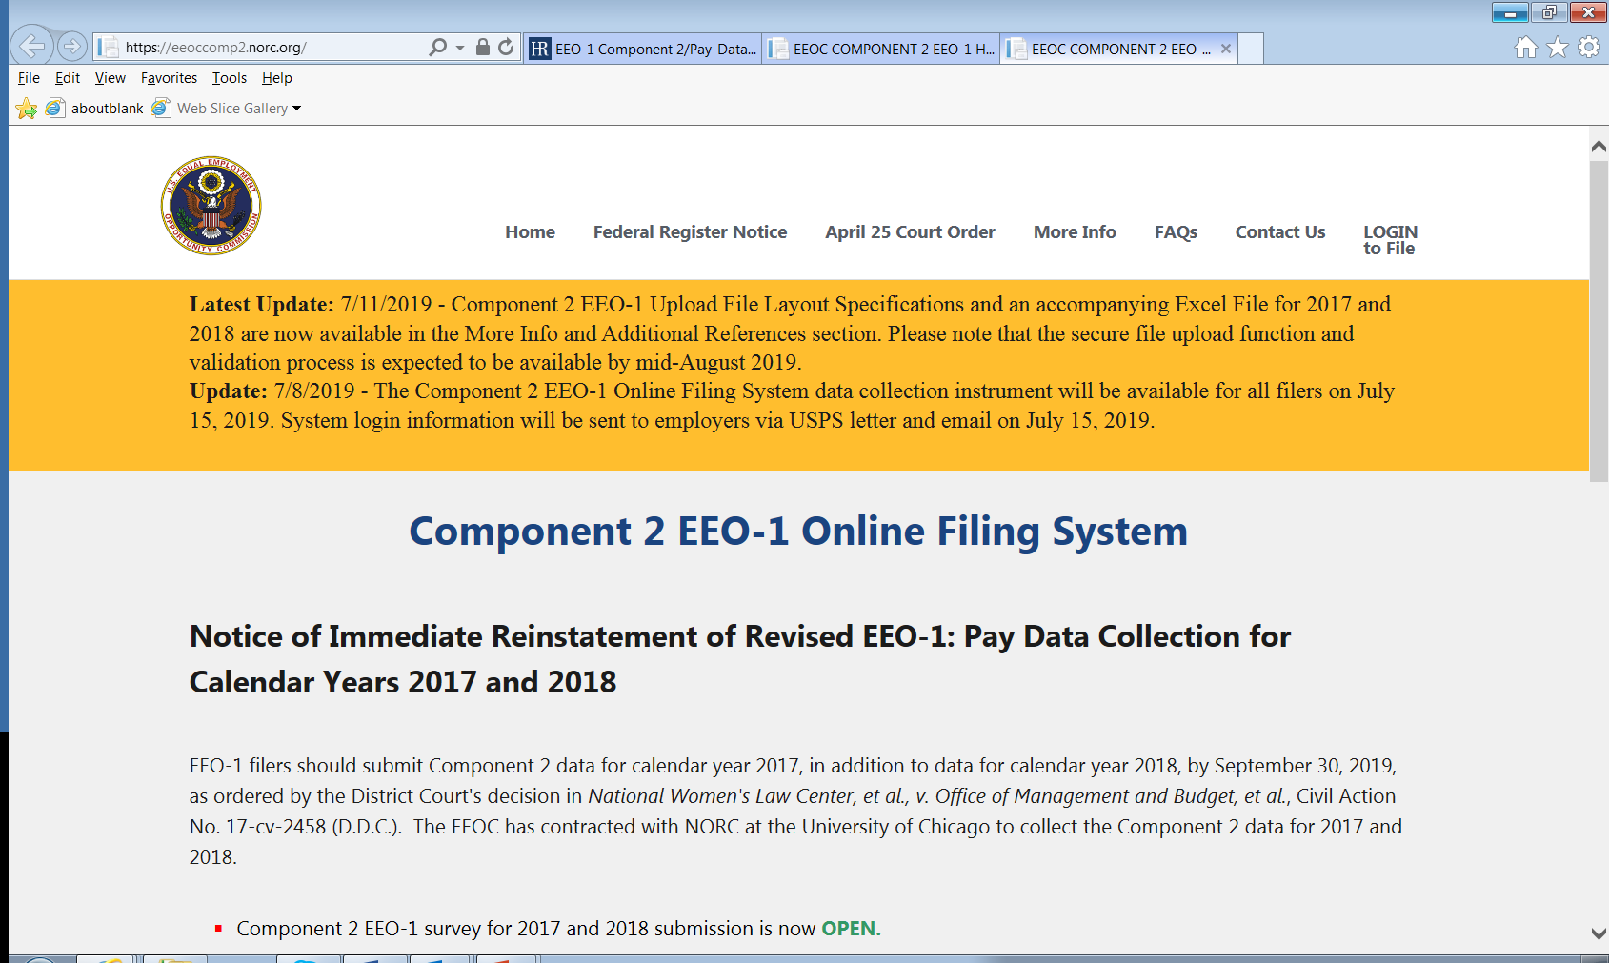

Slide 8
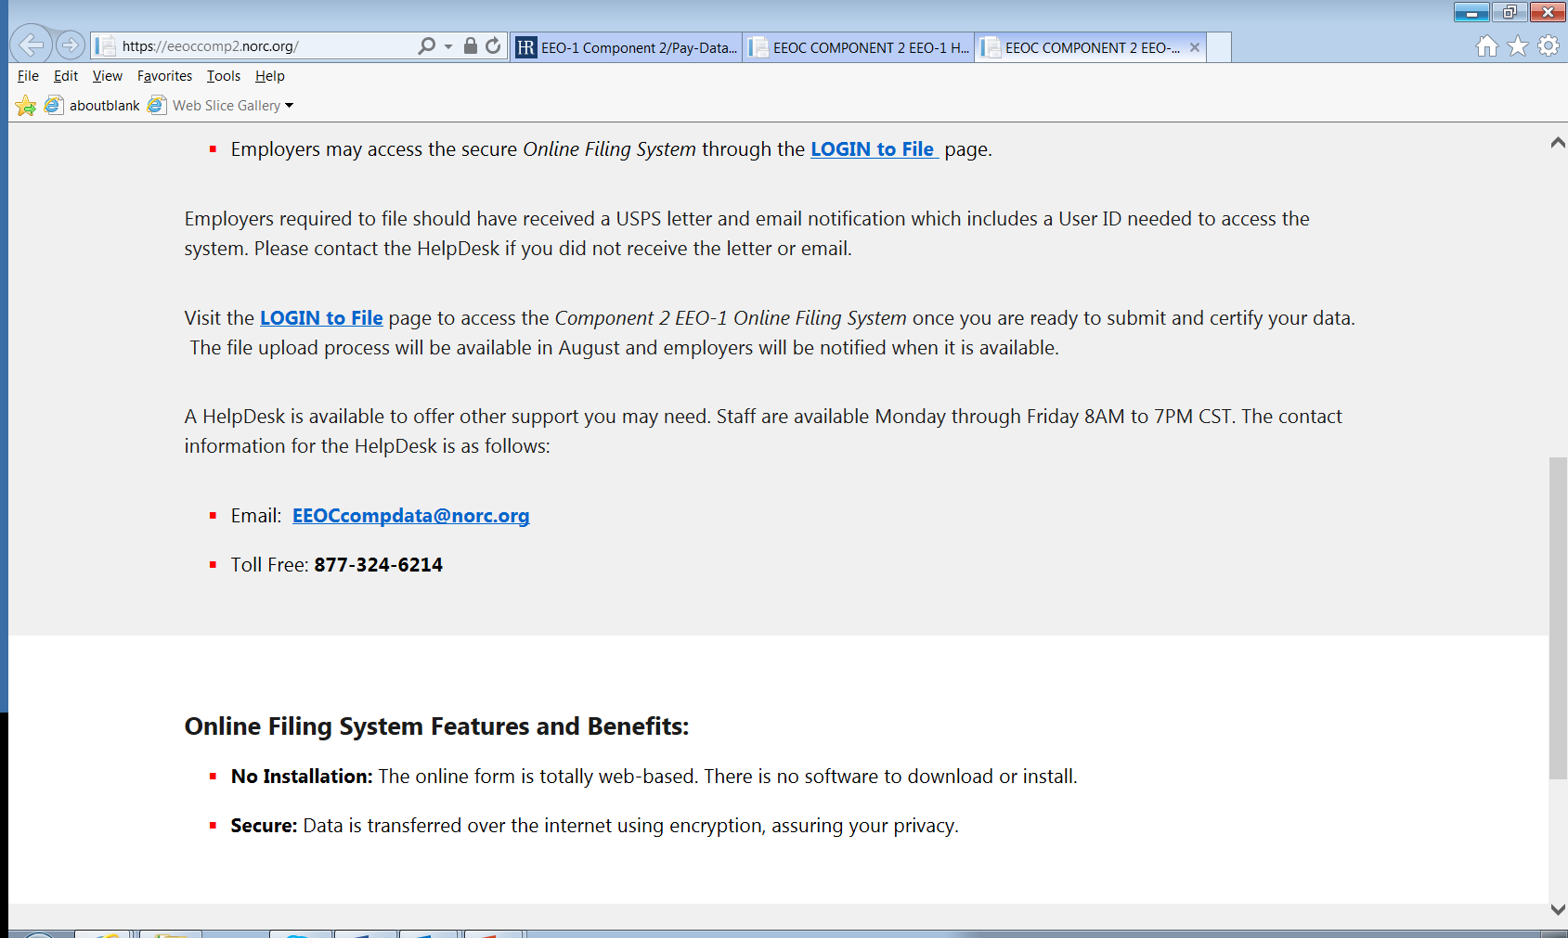

Slide 9

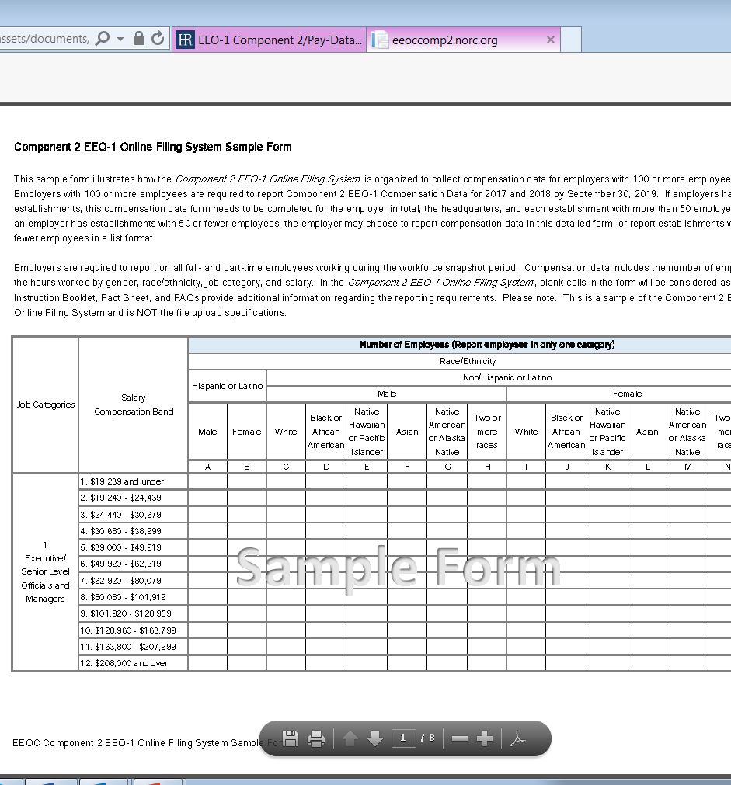
Sample Form the proposed EEO-1 Form to collect pay data in the Component 2 EEO-1 Online Filing System.
https://eeoccomp2.norc.org/assets/documents/Comp2EEO1OnlineFilingSampleForm.pdf

Slide 10
Instruction Booklet for Filers instructions for submitting the Component 2 EEO-1 Report.
https://eeoccomp2.norc.org/assets/documents/Comp2EEO1InstructionBook.pdf

Slide 11
Fact Sheet for Component 2 EEO-1 Report Filers – a list of important deadlines, reminders, and definitions to support a successful submission of Component 2 data for 2017 and 2018 calendar years.
https://eeoccomp2.norc.org/assets/documents/Comp2EEO1FactSheetFinal.pdf

Slide 12
Component 2 EEO-1 Compensation Data Collection Initial Notification – the USPS letter sent on July 1, 2019 to notify companies of the immediate reinstatement of the revised Component 2 EEO-1 collection for 2017 and 2018.

Slide 13
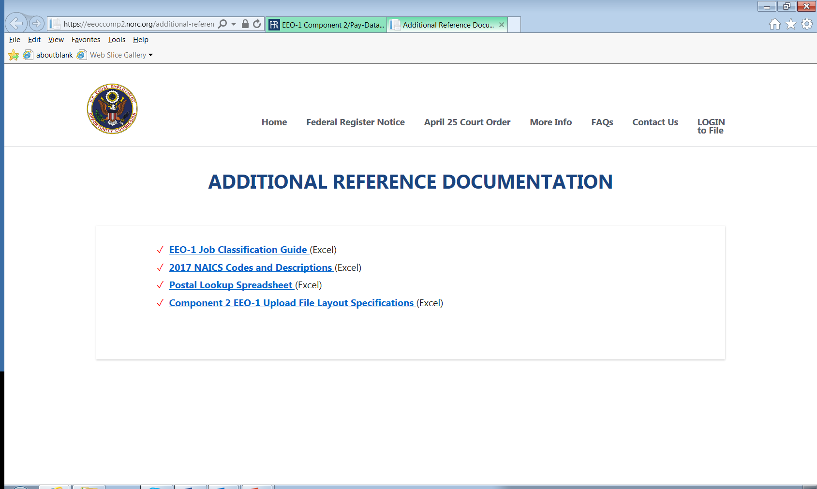

Slide 14
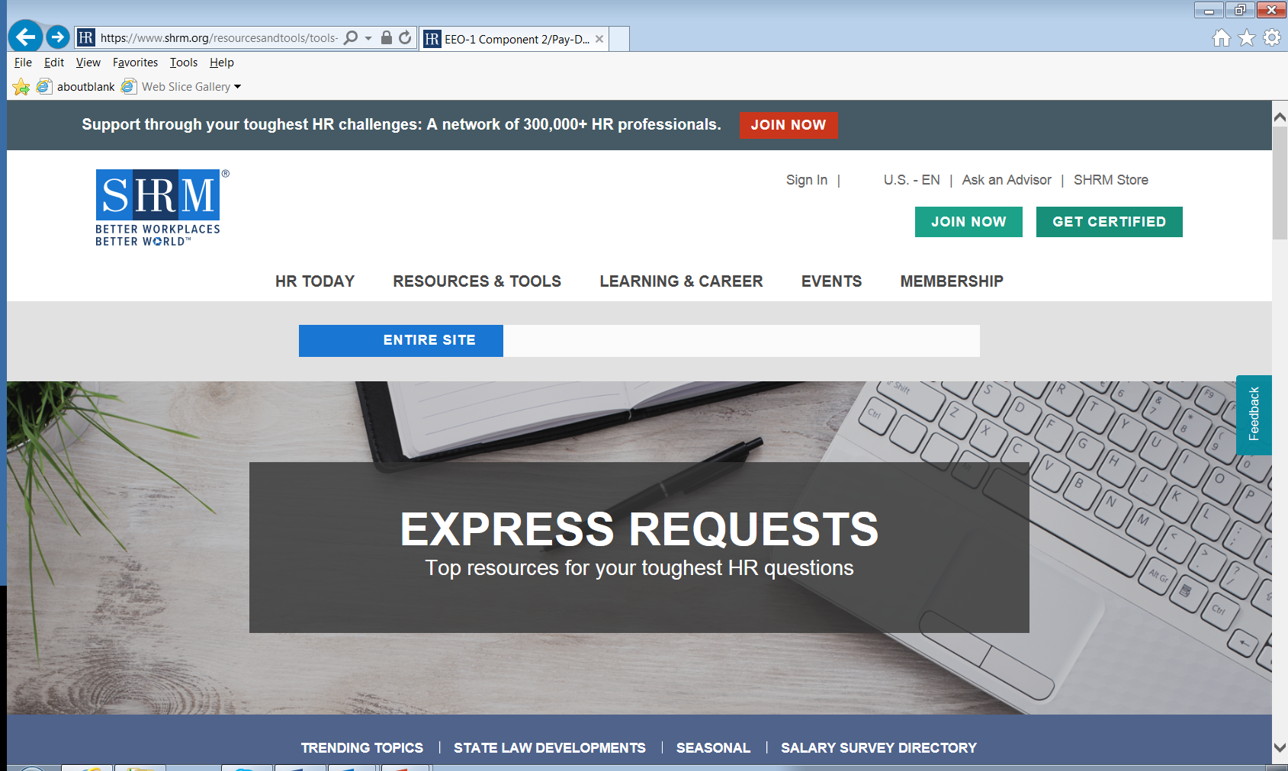

Slide 15
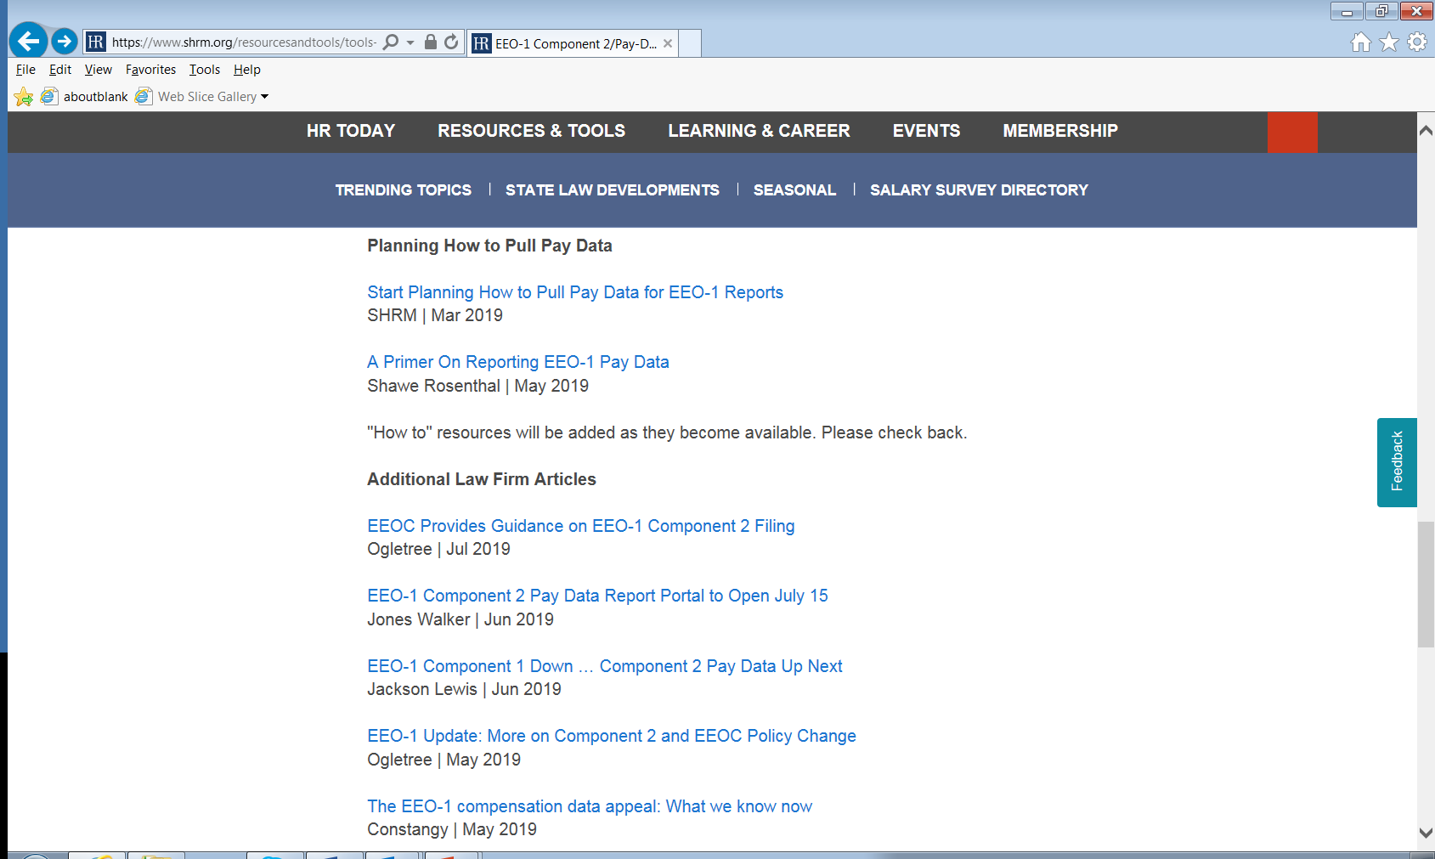

Slide 16
OTHER EEOC NEWS:
OMB stayed the EEO-1 regulations
on expanded information on pay data but overturned by Court and we are gathering that data.
Court issued order staying our wellness regulations (issue with the 30% of employee cost of self-only coverage).
No budgetary issues at this time but no budget passed either.
35 day shutdown in FY 19.

Slide 17

HOUSTON EEOC Update:
We resolved 3,713 cases in Houston alone in FY 2018 (that’s 49.6% of the total charges in Texas).
Enforcement got almost $20,000,000 in monetary benefits FY 2018.
National trend is fewer filings than in the past. We have not seen filings this low since the 1990’s.
Retaliation remains the most common basis for a charge (51.6% nationally covering all statutes). Race and sex are both around 32%.

Slide 18


Contact Information & Resources
U.S. Equal Employment Opportunity Commission
Joe Bontke M.Ed.
Education & Outreach Coordinator
713 907 2855 cell
713 651 4994 Desk
joe.bontke@eeoc.gov
Joe Bontke
@EEOC_Houston
Toll-free: 1-800-669-4000
TTY: 1-800-669-6820
www.eeoc.gov
eeoc.traininginstitute@eeoc.gov

